Slide 1
Applied Data Science Capstone
Capstone Project - The Battle of Neighborhoods

Slide 2
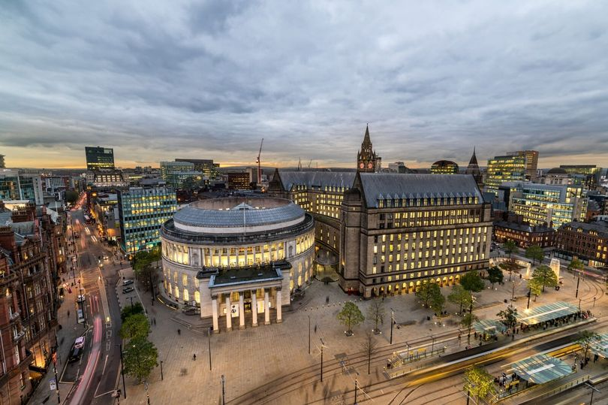
Predicting best place for Indian Restaurant at Manchester
The City of Manchester is the second biggest city in the United Kingdom. It is:
A multicultural and multi-ethnic populated city.
Second most peoples from Asia are leaving in this city.
Famous for the different business operations and official hub.
Various businesses are playing in the market in Manchester.
The city is a significant centre for retailing, world trade, transportation, tourism, real estate, media, advertising, legal services, accountancy, insurance, fashion, and the arts in the United Kingdom.

Slide 3
Data acquisition and cleaning
Data accused from two places followed by clean of it,
1
First set of data collected from the wiki page of Manchester post codes from the link of: https://en.wikipedia.org/wiki/M_postcode_area
2
Second set of data collected from the git hub for the longitude and latitude of Manchester post codes. https://raw.githubusercontent.com/binodpanda/github-example/master/manchester_uk_cordinates.csv
3
From the first source of data set there are multiple records for same post code is present. It is required to clean those.
4
We are interested on Indian restaurants, so remove all other venues from the datasets.

Slide 4
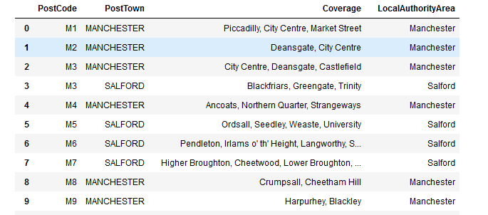
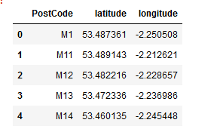
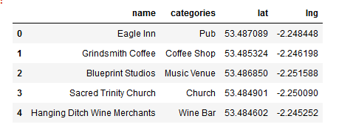
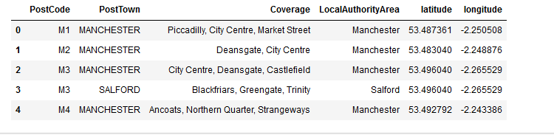
Sample data formats.

Slide 5
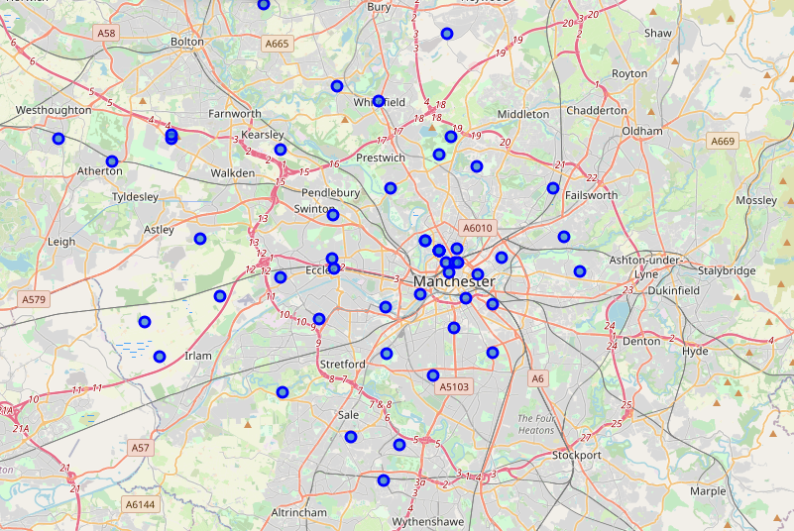
Map of Manchester city and its venues

Slide 6
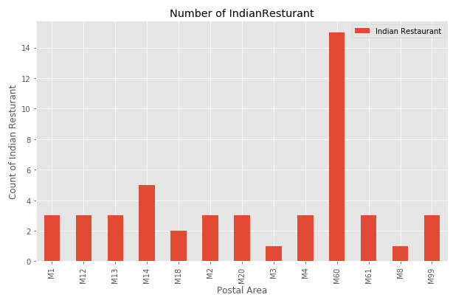
Predictive analysis
There are 13 postcodes out of 52 have Indian restaurants.
Highest number of restaurants at M60 areas.
Lowest number of restaurants at M3 area.
There are four places have same number of restaurants.
The area having highest number of restaurants predict that it is comitative area and more Indian or Asian peoples are staying.
From the map we understood that there M60 is out city of main city area and mostly residential area.

Slide 7
Conclusion and future actions
To start a new comitative Indian restaurant it is good to start at the area of the M60.
It is advisable to open its branches slowly to other areas starting from M14.

